Slide 1
CSS HANDBOOK

Slide 2
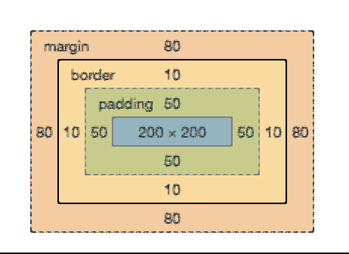
CSS BOX MODEL
Margin: It is the space around the element.
Padding: It is the space between the element.
Border: It appears directly between margin and padding of element and allows you to define the border area of element.

Slide 3
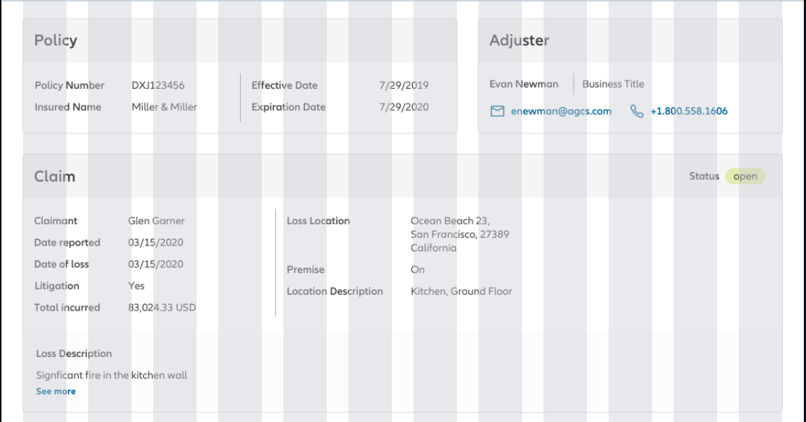
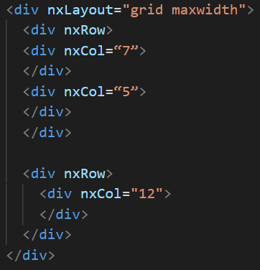
GRID LAYOUT
32px padding
1 2 3 4 5 6 7 8 9 10 11 12
Every page is divided into 12
equal columns.
We need gutters so we will not use
nopadding or nogutters in nxLayout.
Link: https://ngx-ndbx.frameworks.allianz.io/documentation/grid/overview

Slide 4
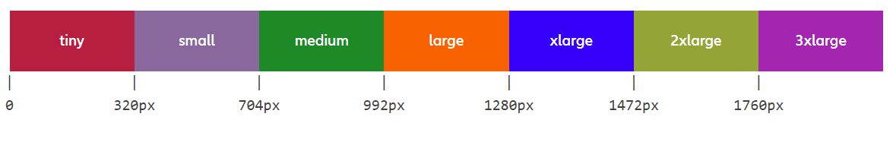
BREAKPOINTS
Instead of using media query to mutate the width of the container. Use breakpoints (present in NDBX layout):
Use Case: If you have a requirement to make a container that occupies full width in lower resolutions and half width of viewport for high resolutions. For this scenario we use the following
<div nxCol=“12,12,12,6,6,6”> </div>
Link: https://ngx-ndbx.frameworks.allianz.io/documentation/grid/overview#breakpoints

Slide 5


DEFAULT NDBX CLASSES FOR STYLING
NDBX has a set of predefined styles that can be directly used by providing the class name in your HTML code.
Headline: https://ngx-ndbx.frameworks.allianz.io/documentation/headline/overview
Copytext: https://ngx-ndbx.frameworks.allianz.io/documentation/copytext/overview
Margins: https://ngx-ndbx.frameworks.allianz.io/documentation/layout/overview
If you want to apply a margin top of 16px, instead of adding margin-top: 16px in CSS. We will use:
For font weight, use: https://ngx-ndbx.frameworks.allianz.io/documentation/typography/overview
Don’t use custom styles for font sizes and margins.

Slide 6
SPECIFICITY RULE IN CSS
If there are two or more conflicting CSS rules that point to the same element, the browser follows some rules to determine which one is most specific and therefore wins out.
Specificity Hierarchy:
We should always use IDs, classes, attributes and pseudo-classes instead of !important/ inline styles.
!important
Inline Styles
IDs
Classes, Attributes and pseudo-classes
Elements and pseudo-elements
*
Most Specificity Value
Least Specificity Value

Slide 7
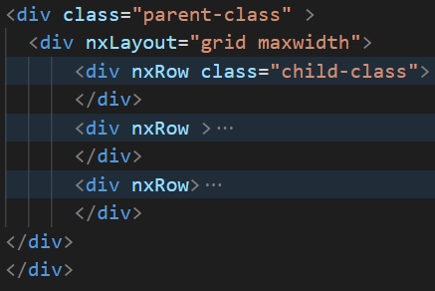
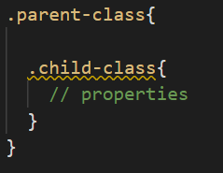
VIEWENCAPSULATION
ViewEncapsulation.None: Angular does not apply any sort of view encapsulation meaning that any styles specified for the component are actually globally applied and can affect any HTML element present within the application. This mode is essentially the same as including the styles into the HTML itself.
This helps us in changing the styles of NDBX components, but this affects the component globally, so we need to add a parent class in html in order wrap all the styles inside a parent class.
TypeScript: HTML: CSS:

Slide 8
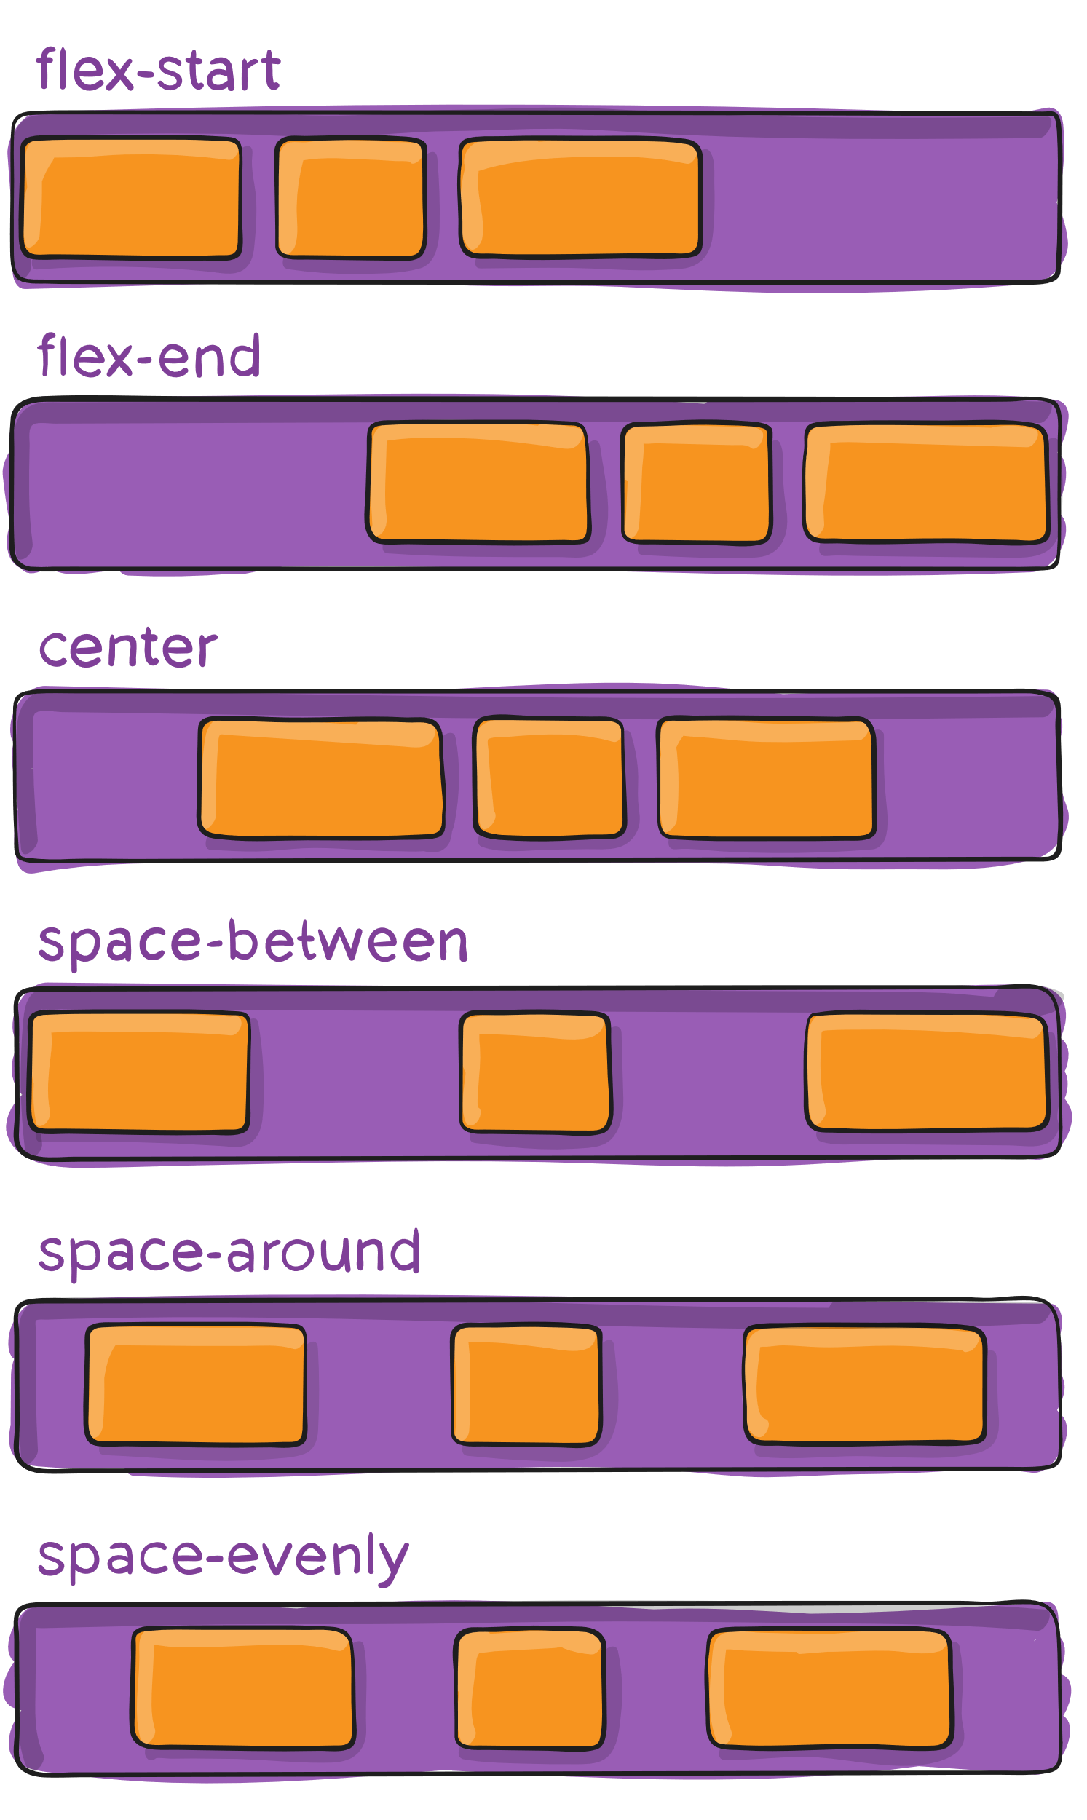
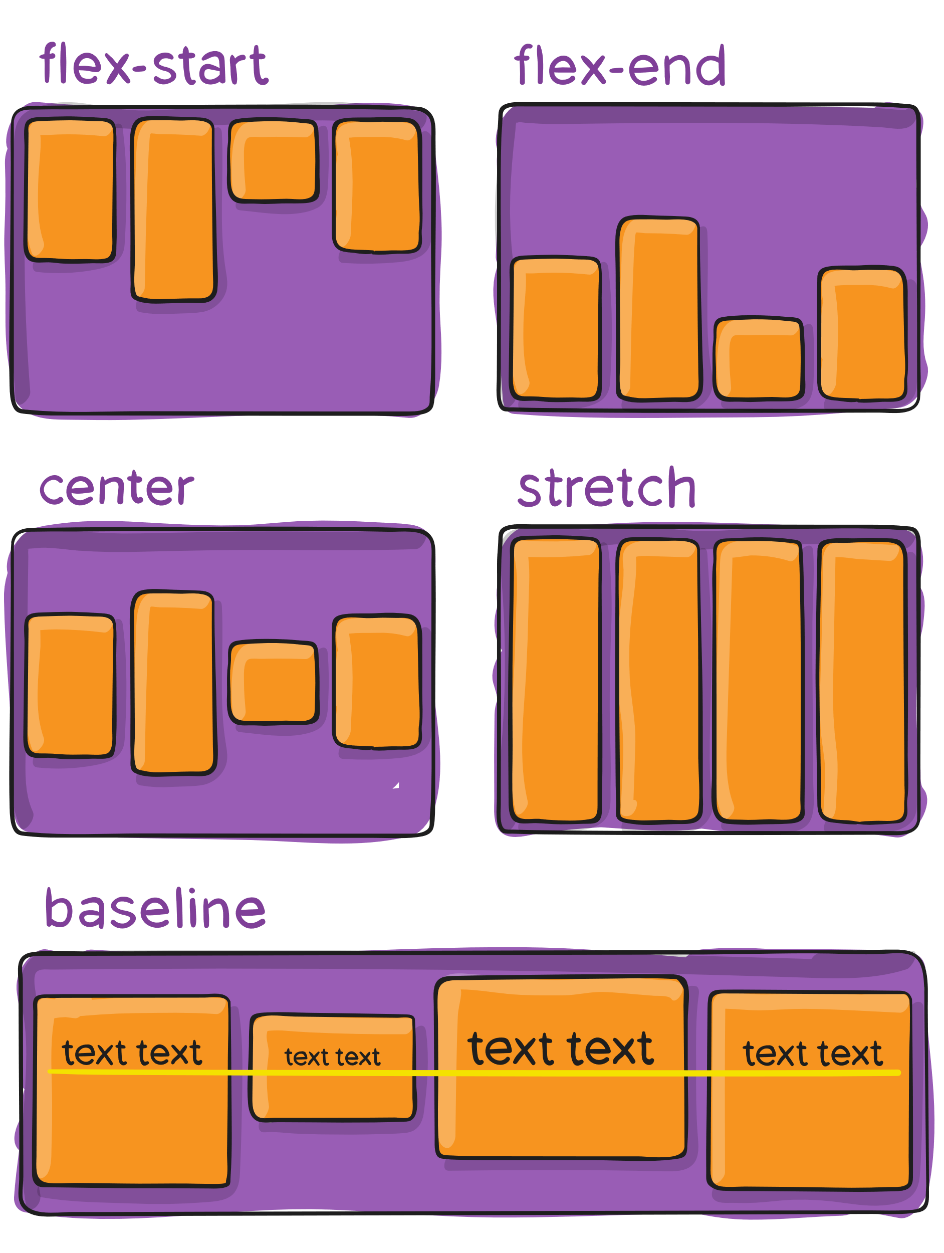
FLEXBOX
Flexbox helps in developing responsive web design and comes in handy when you need to align elements.
Flexbox is mainly used for scaling, vertically and horizontally aligning and reordering content inside a container.
We mainly use justify-content and align-items in our project.
Don’t use flexbox for page layout, use grid (NDBX) instead.
To learn more, please visit: Flexbox Froggy
justify-content: align-items:

Slide 9
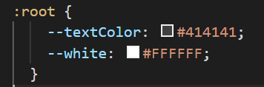

POINTS TO REMEMBER
Don’t use fixed widths and heights. Use padding instead.
Avoid using inline styles and !important.
NxRowJustify in NDBX doesn’t have the value center. Please don’t assign center to this property.
Use global CSS (styles.scss) whenever you want to apply styles across the portal.
Don’t use negative value of css unit.
Don’t use nxCol directly inside nxLayout. Always wrap it inside nxRow.
In order to reduce repetition in CSS, please use variable.css. We mainly use variable.css for brand colors which makes it relatively easier to refactor code.
Add variable under :root (variable.css)
for global scope and then access it using
var()

Slide 10
LEARNING EXTRAS
Selectors: https://code.tutsplus.com/tutorials/the-30-css-selectors-you-must-memorize--net-16048
Combinators: https://developer.mozilla.org/en-US/docs/Learn/CSS/Building_blocks/Selectors/Combinators
CSS Units: https://www.w3schools.com/cssref/css_units.asp
Inherited Property Rule: https://www.sitepoint.com/css-inheritance-introduction/
Specificity: https://developer.mozilla.org/en-US/docs/Web/CSS/Specificity
Cheat Sheet: https://webdevsimplified.com/specificity-cheat-sheet.html

